Slide 1

POVs and Experience Prototypes
SYSTEMIC JUSTICE AND EQUALITY
Lainey Wang, Nancy Hoang, Fernanda Kramer, Britney Tran

Slide 2

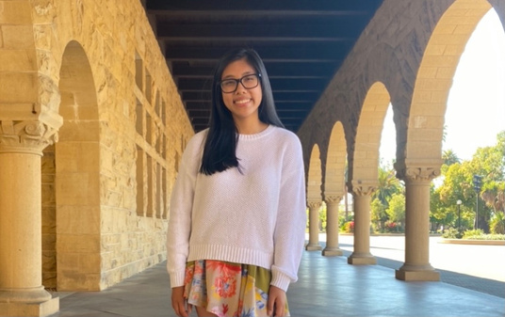
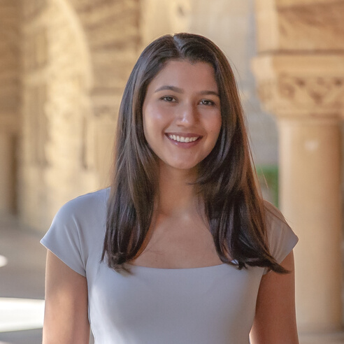

The Team
Lainey Wang
Nancy Hoang
Fernanda Kramer
Britney Tran

Slide 3


Problem Domain
Fostering conversation and empathy for identities different from one's own

Slide 4
Initial POV
We met Trish who is an undergraduate studying Info Science at UT Knoxville.
We were surprised to realize that she changed her major because she felt isolated as the only woman in her CS classes, and belittled when her male counterparts spoke down to her.
We wonder if this means that regardless of her skill set, what drives her choice in major is her environment and peers, specifically how welcoming they are.
It would be game-changing to find a way for women to feel they belong in STEM, even if they are alone physically.

Slide 5



Additional Needfinding
Raena
Amber
Susan
36, Equity Team at Facebook
23, Delivery Driver for a Cannabis Dispensary
mid 50s, Software Engineer at Hitachi

Slide 6
"They pertain to all of us. We are all living in the world and effected by how equitable or inequitable the systems are."
Raena

Slide 7
"What comes to mind when you hear 'systemic justice issues'?"
"The various ways parents raise their children and how sometimes that's harmul to a child's perspective on the world."
Amber

Slide 8
black people occupy how many - 13% of the population? But if you count the number in jail, how many are black? Maybe 50%? ... Is that because of the system? No I don't think so.
because they committed some crime. That's why they were put in prison.
"From my personal experience,
I think that's based on fact,
Susan
Not because of
systematic tragedies."

Slide 9

POVs & HMWs

Slide 10

POV 1
We met Trish who is an undergraduate studying Info Science at UT Knoxville.
We were surprised to realize that she changed her major because she felt isolated as the only woman in her CS classes, and belittled when her male counterparts spoke down to her.
We wonder if this means that regardless of her skill set, what drives her choice in major is her environment and peers, specifically how welcoming they are.
It would be game-changing to make educational environments welcoming regardless of identity.
Trish

Slide 11
POV 2
We met Susan, a 56 year old, conservative Asian immigrant who is a software engineer at Hitachi Energy.
We were surprised to realize that she claims racism towards Black people is not a systemic issue, but rather a result of statistics/lived experience while she points out systemic issues towards anti-Asian hate such as lack of media coverage and diversity in education.
We wonder if this means that she has developed an unempathetic view of Black people because she has not met enough to see them as people rather than statistics.
It would be game-changing to bring people together from different POC groups to share stories and increase perspective and understanding.
Susan

Slide 12
We met Susan, a 56 year old, conservative Asian immigrant who is a software engineer at Hitachi Energy. We were surprised to realize that she claims racism towards Black people is not a systemic issue, but rather a result of statistics/lived experience while she points out systemic issues towards anti-Asian hate such as lack of media coverage and diversity in education. We wonder if this means that she has developed an unempathetic view of Black people because she has not met enough to see them as people rather than statistics. It would be game-changing to bring people together from different POC groups to share stories and increase perspective and understanding.
How might we encourage people to learn and empathize with issues that do not affect themselves?
How might we explain concepts of oppression with more emotion/stories rather than statistics?

Slide 13
POV 3
We met Amber, a 23 year-old woman from Los Baños, CA who works as a delivery driver for a cannabis dispensary.
We were surprised to realize that she said nothing else comes to mind when she thinks of systemic inequity besides the parents someone is born with and the perspectives they provide.
We wonder if this means that she is upset at her parents for not offering her diverse perspectives and feels they inhibited her development as an open-minded individual.
It would be game-changing to provide children with mentors outside their parents to help offer them new perspectives that their parents cannot.
Amber

Slide 14
We met Amber, a 23 year-old woman from Los Baños, CA who works as a delivery driver for a cannabis dispensary. We were surprised to realize that she said nothing else comes to mind when she thinks of systemic inequity besides the parents someone is born with and the perspectives they provide. We wonder if this means that she is upset at her parents for not offering her diverse perspectives and feels they inhibited her development as an open-minded individual. It would be game-changing to provide children with mentors outside their parents to help offer them new perspectives that their parents cannot.
How might we leverage the internet to create educational spaces outside the classroom for children to learn to recognize and develop sensitivity to the needs of people with identities different than their own?

Slide 15

Solutions &
Experience Prototypes

Slide 16
How might we encourage people to learn and empathize with issues that do not affect themselves?
Create a platform that allows users to anonymously ask non-politically correct questions they would be uncomfortable asking in person

Slide 17
Experience Prototype 1
Asking about Identity Anonymously
Assumption:
People are uncomfortable asking personal questions about racial experiences in person but are willing to anonymously.
What we did:
moderated a conversation between two people anonymously through text on Jamboard
guiding questions
strangers discussed racial, cultural, and other identity topics
short 5 minute interview
Emily, 20, Vietnamese-American,
Web Design Major
&
Jessica, 20, Ghanaian-American, Education Major

Slide 18

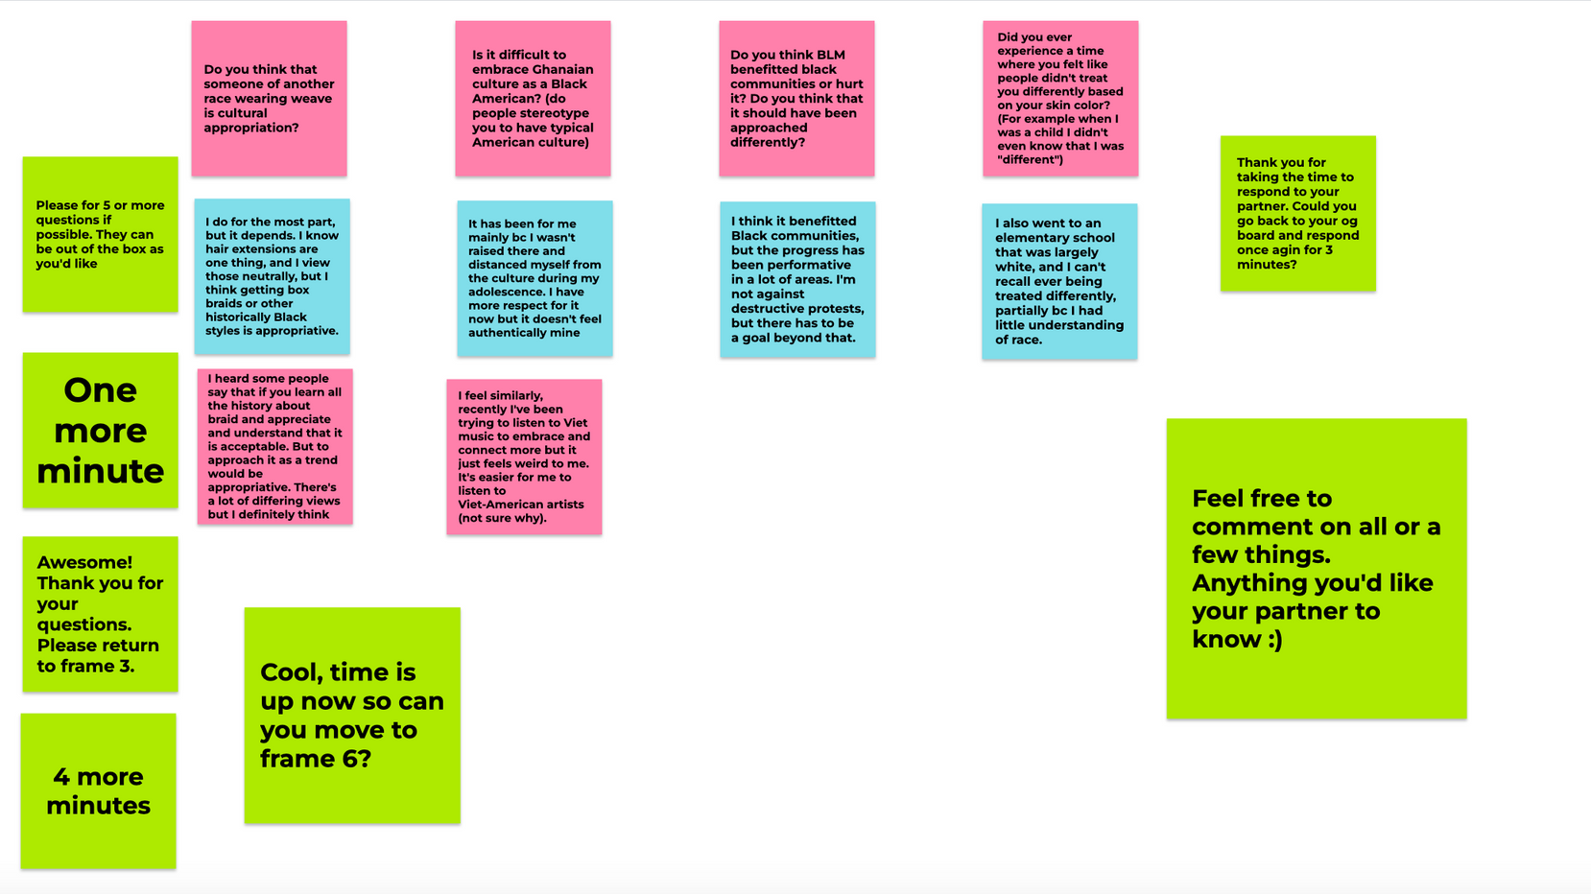

Slide 19




Results
What worked
What didn't work
Surprises
Learnings
text platform
guiding questions
having a live moderator present
race of other participant mattered
POC felt comfortable with another POC
remained guarded even with anonymity
participants care to know background of other participant
background= security

Slide 20


Results
Were the assumptions valid?
New assumptions?
Participants felt more comfortable asking questions about identities anonymously
Participants feel more comfortable speaking about racial experiences with other POC if they are also POC.

Slide 21
How might we encourage people to learn and empathize with issues that do not affect themselves?
Leverage their friends and family; make an educational app that helps guide you through how to talk to a family member/friend about polarizing issues.

Slide 22

Experience Prototype 2
Polarizing Parley with a Parent
Assumption:
People would find conversations about polarizing issues easier once they have some guidance.
What we did:
pre-interview
Guidance Cards
Mock conversation with participant's "parent" about a polarizing issue, experimenter served as the stand-in "parent."
post-interview
Bella, Filipino-American, Education Coach @ Guild Education

Slide 23
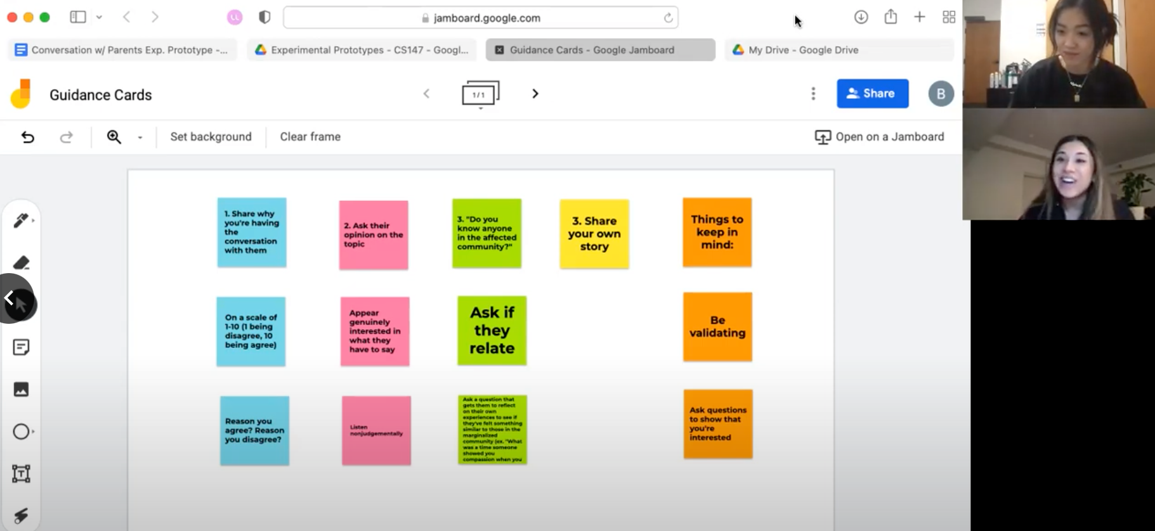

Slide 24
Results
What worked
What didn't work
Surprises
Learnings
guidance questions used by participant
produced a "productive" conversation
inauthentic conversation
“I am very emotionally driven and looking at those cards helped me process. I was able to ask about how you’re feeling that way instead of just disagreeing immediately"
the goal is to have productive and informative conversations, not to change the other's mind

Slide 25
Results
Were the assumptions valid?
New assumptions?
Guidance was helpful in navigating conversations about polarizing issues.
People become emotional when their parents disagree with them on polarizing topics.

Slide 26
How might we leverage the internet to create educational spaces outside the classroom for children to learn to recognize and develop sensitivity to the needs of people with identities different than their own?
Develop an app for cooking cuisine from different cultures which also helps you learn about the story behind dishes.

Slide 27

Experience Prototype 3
Conversations through Cuisine
Assumption:
People want to learn more about the culture behind the foods they eat
What we did:
Give people an ~ethnic~ snack and have a conversation about it to see if they’ll ask about the culture behind it
Carol, 24, Software Engineer
&
Mary, 23, Product Manager

Slide 28
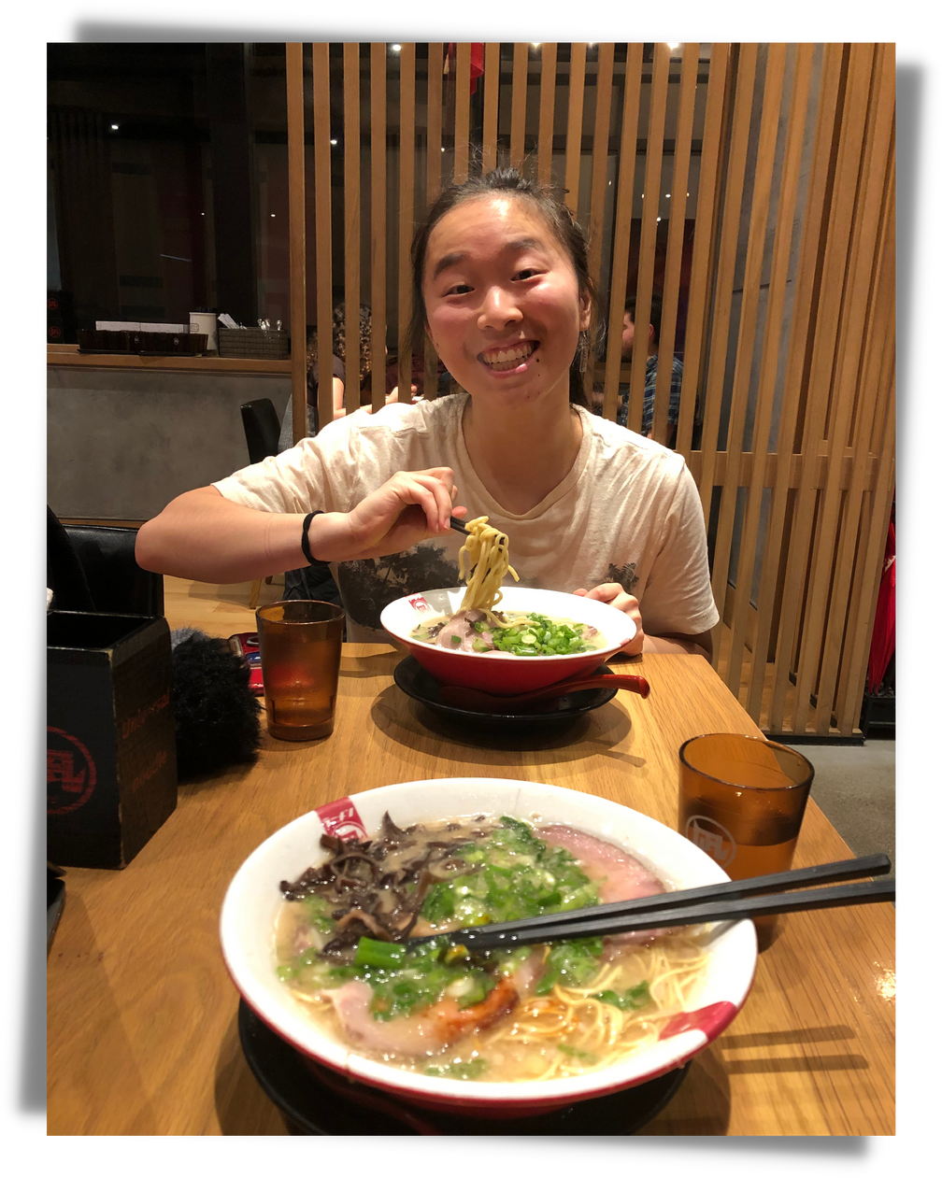
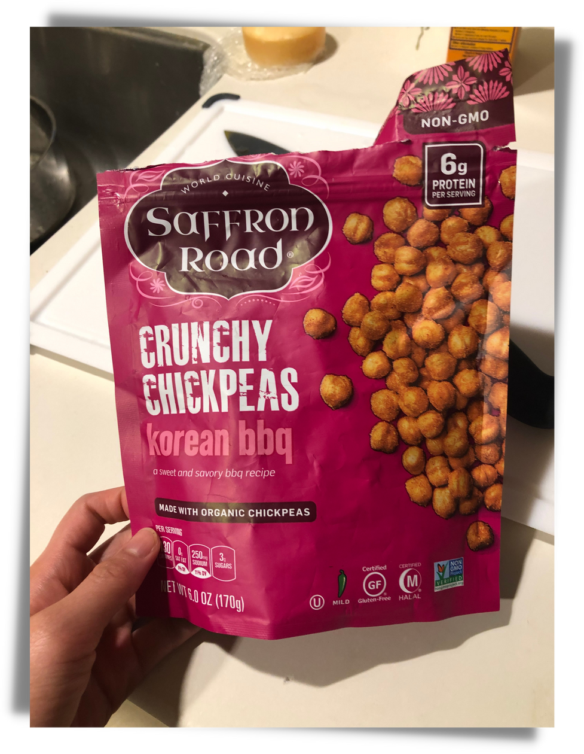

Slide 29
Results
What worked
What didn't work
Surprises
Learnings
eating cultural foods led to an increased connection to that culture
participants did not inquire about the culture, but instead about details specific to the dish (i.e. taste, price)
when asked what the foods reminded participants of, responses differed based on the food. Ramen led to personal stories, and chickpeas led to culture-specific stories.
the experience of cooking the food is different than that of tasting it.
better design may have included participants cooking the food

Slide 30

Results
Were the assumptions valid?
New assumptions?
Tasting cuisine from a culture did not increase desire to learn about the culture.
The experience of cooking food makes people want to learn more about the culture behind the foods.

Slide 31

Summary
Key Takeaways
People feel more comfortable asking questions about the experiences of people with different identities anonymously.
Safety is key! Prevent trolls.
POC users appreciate speaking with other POC users.
Guiding questions are helpful when navigating difficult conversations about polarizing topics.
Productive and informative conversations > Changing their beliefs
Inauthentic conversations are not helpful.

Slide 32

Summary
Next Steps
Identify how we can help users feel safe while asking controversial questions anonymously
Identify how we can guide conversations to be productive while maintaining authenticity

Slide 33

Thank you!

